Slide 1
Ionic and Covalent Bonding

Slide 2
Valence Electrons
Valence electrons are the electrons in the highest occupied energy level of an atom (outer shell).
What element does this Bohr model represent? Hint: How many protons are in the nucleus?
Outer shell with valence electrons
+ + +
+ + +
+ +
Oxygen

Slide 3
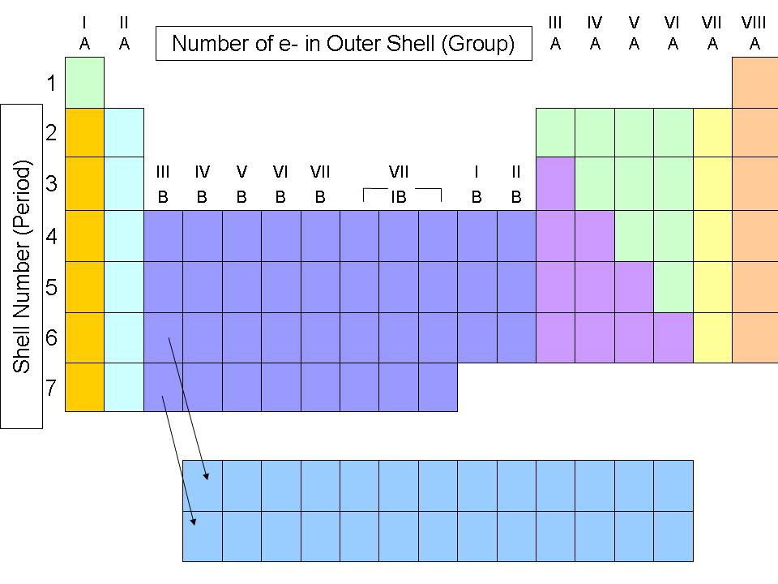
Valence electrons
To find the number of valence electrons for a representative element (A columns) simply look at its group number.

Slide 4
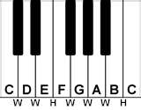
Octet Rule
An “octet” is a set of eight.
Octet Rule:
Atoms are stable when they have eight electrons in their outer shell.
In order to become stable they will gain, lose or share electrons with other atoms. They will form bonds.

Slide 5
Metals & The octet rule
Metals: tend to lose their valence electrons, leaving a complete octet in the next lowest energy level.
An atom’s loss of valence electrons produces a cation, or a positively charged ion.
For example: Sodium is a metal with 1 valence electron. It will tend to lose that negatively charged electron thereby becoming more positive. We would write that as Na⁺

Slide 6
Nonmetals & The octet rule
Nonmetals: tend to gain valence electrons or to share valence electrons with other nonmetals in order to achieve the stable octet.
An atom’s gain of valence electrons produces a anion, or a negatively charged ion.
For example: Oxygen is a nonmetal with 6 valence electrons. It will tend to gain two negatively charged electron thereby becoming more negative. We would write that as O²⁻

Slide 7
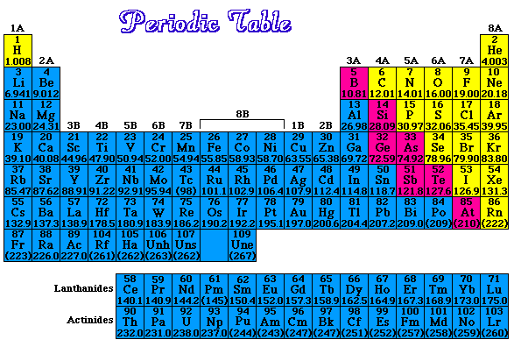
Ionic Bonds
Ionic bonds are bonds that form between metals and nonmetals.
Blue = metals
Yellow = nonmetals

Slide 8
Ionic Bonds
Metals lose electrons (cations) and nonmetals gain electrons (anions).
Anions and cations have opposite charges. They attract one another by electrostatic forces.
The forces of attraction that bind these oppositely charged ions are called ionic bonds.
Na + Cl Na⁺ [ Cl ]⁻

Slide 9
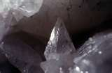
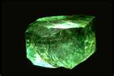
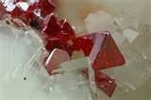

Ionic Bonds
Properties of Ionic Compounds
Most are crystalline solids at room temperature.
High melting points.
When melted, they can conduct an electric current.
Conduct electricity if they are dissolved in water.

Slide 10
Covalent Bonds
Covalent bonds occurs when atoms “share” electrons.
Nonmetals bind to other nonmetals
For example: 1 atom of fluorine with bond with another atom of fluorine and share electrons.
F + F F F

Slide 11
Covalent Bonds
Types of covalent bonds
Single covalent bonds- involve only one shared pair of electrons. (F2)
Double covalent bonds- involve two shared pairs. (O2)
Triple covalent bonds- involve three shared pairs. (N2)
Coordinate covalent bonds-one atom contributes both bonding electrons. (CO)

Slide 12
Covalent Bonds
Properties of Covalent Compounds
Generally have lower melting and boiling points than ionic compounds.
Poor conductors of electricity
Aren’t very soluble in water
Tend to be more flammable than ionic compounds.

